Slide 1

Amazon Reviews for Sentiment Analysis
MSc. Data and Business Analytics -
Fil rouge Project
ETU20231137 Chia-shuo YANG
ETU20231136 Maximilian SOMMERFELD
ETU20231057 Chia-chi CHEN
ETU20230394 Merearii LI

Slide 2

Outline
Project objective
Data description & Exploratory analysis
Data cleaning
Feature Engineering
1
5. Transformation and vectorization
Model building
Model training and results
8. Conclusion and business application
9. Resources
8

Slide 3






1. Project objective
Sentiment analysis is applied various areas of research and business
Text mining tool in the field of natural language processing
Understand opinions in large amount of data containing different languages
Amazon product reviews from Kaggle
Natural language Processing through deep learning
Sentiment Analysis
Notes:
The objective for our group for choosing the topic is, we all know that, every companies have huge amount of opinions online, social media, google maps, in every each website. For these large amount of the data, we can apply the tool of natural language to do the sentimental analysis.

Slide 4
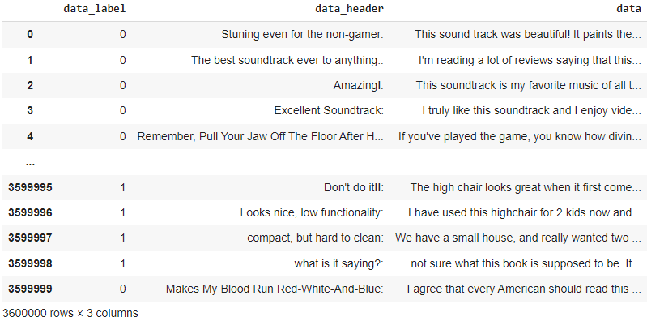


2. Data description
Data
Label 0
4. and 5. stars reviews
Label 1
1. and 2. stars reviews
Training
3,600,000
Reviews
Testing
400,000
Reviews
3. star reviews considered neutral - won't be analyzed

Slide 5
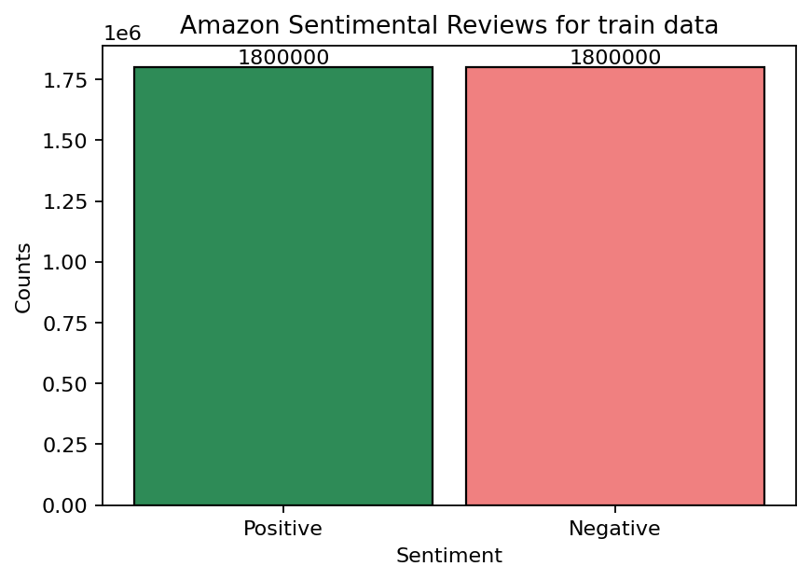
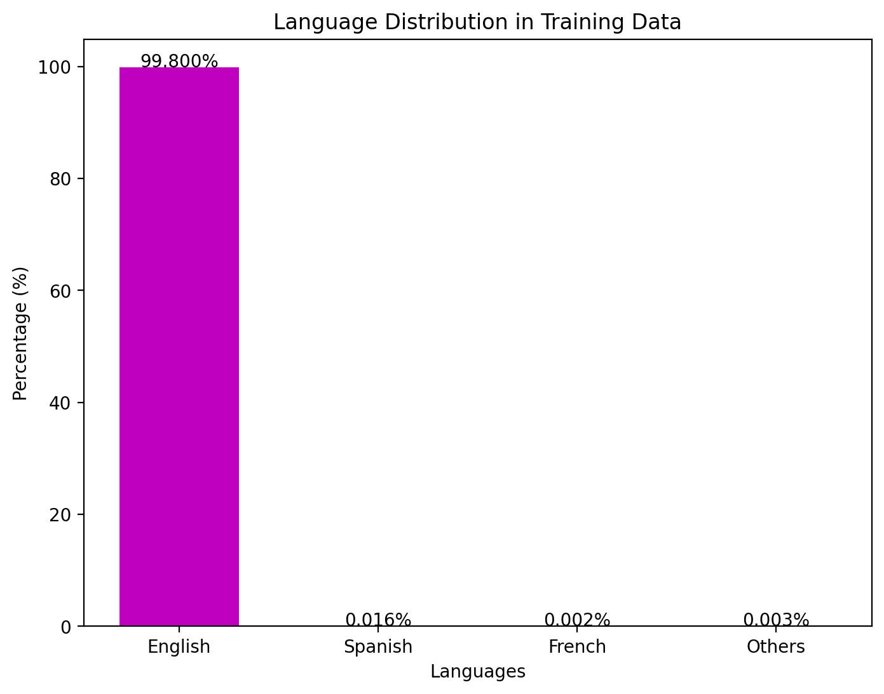

2. Data description – Label
Label Distribution
Language Distribution
le6
Identified 8 more languages in our data set
English is the major language used in the reviews
We will therefore focus on English comments in for model training

Slide 6
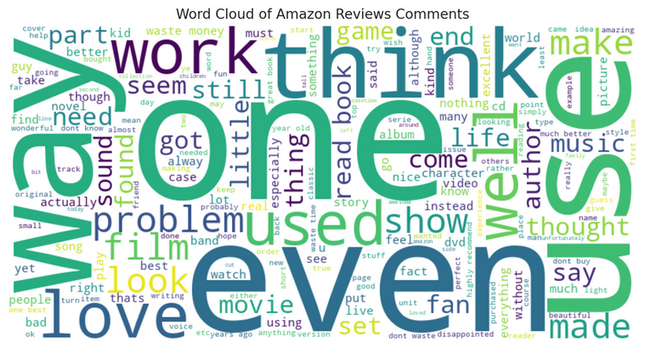
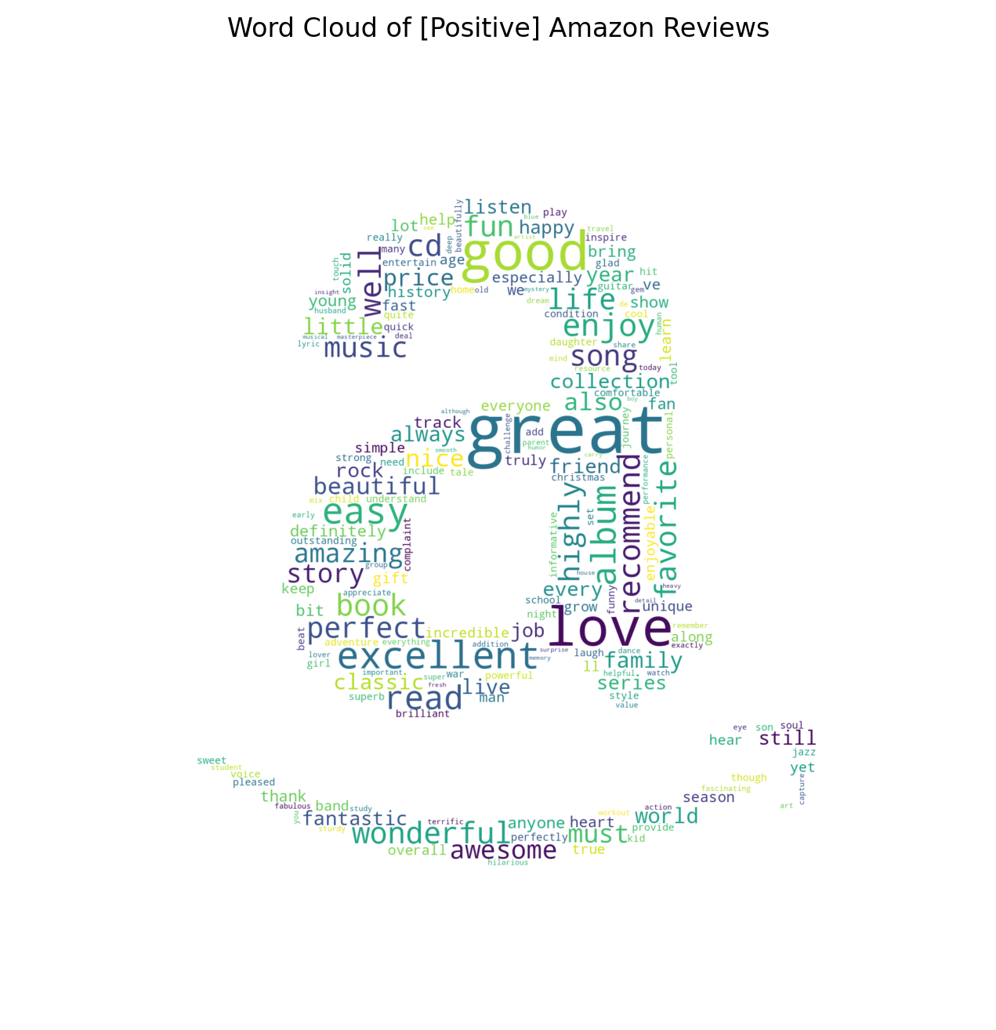
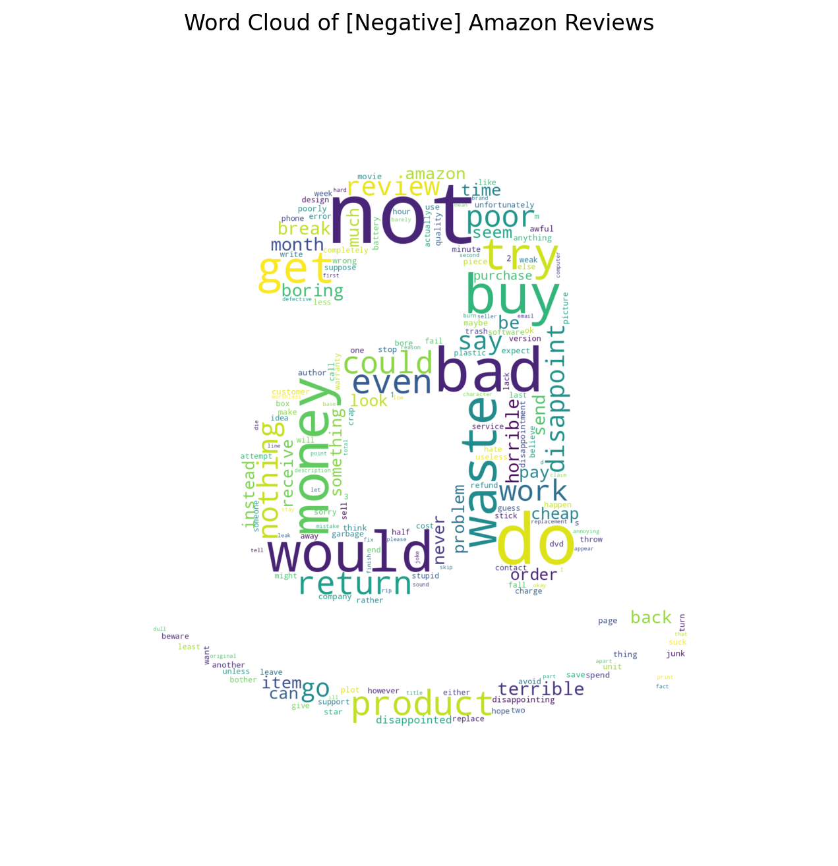

2. Data description – Word occurrence
RAW Comments
Positive comments cleaned
Negative comments cleaned
Deleting unrelated words
Word lemmatization

Slide 7

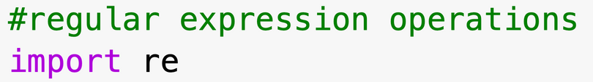
3. Data cleaning – Basic
TOOL
CLEANING | PURPOSE | CODE
Lowercase | A -> a
Forward and backward slash | Replace „/“, „\“
Alphanumeric characters and numbers | Delete characters and numbers
Consecutive spaces | Useless additional spaces
Notes:
Normalize data
Declutter data
Facilitate Analysis
Minimize risks of errors and redundancy
Noise

Slide 8
3. Data cleaning - Advanced
TOOL
CLEANING | PURPOSE | CODE
Emails | Declutter data
URLs | Declutter data
Un-Abbreviation | "aren't" -> "are not” "can't" -> "can not”
Notes:
Normalize data
Declutter data
Facilitate Analysis
Minimize risks of errors and redundancy
Noise

Slide 9
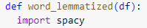
3. Data cleaning – Keywords concentration
CLEANING | PURPOSE | View
Stopwords | Words widely used but hold little useful information
Consecutive characters | Avoid redundancy
Lemmatized words | Reduce words to their roots - Lemma
Amazzzing
Amazzzzzing
Aaamazing
Amazing
Love
Loved
Loving
Lover
Love
Notes:
Normalize data
Declutter data
Facilitate Analysis
Minimize risks of errors and redundancy
Noise

Slide 10
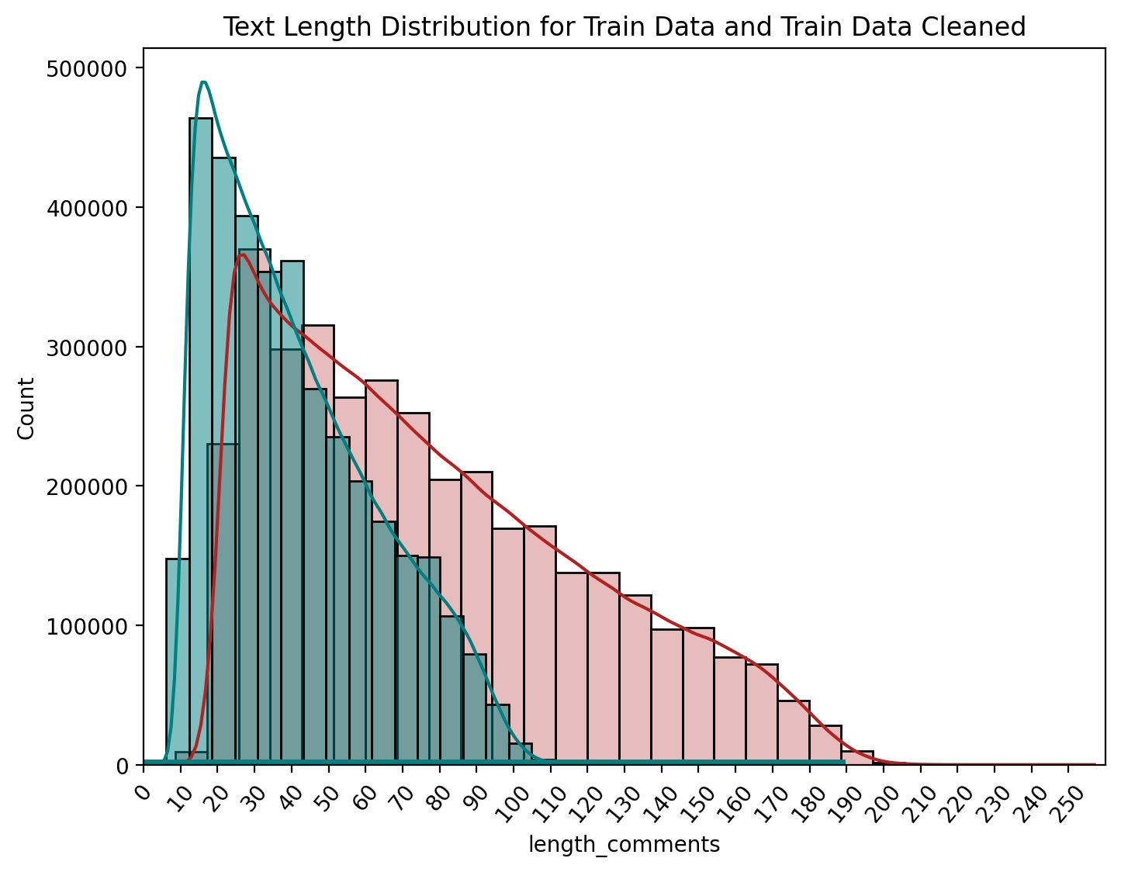
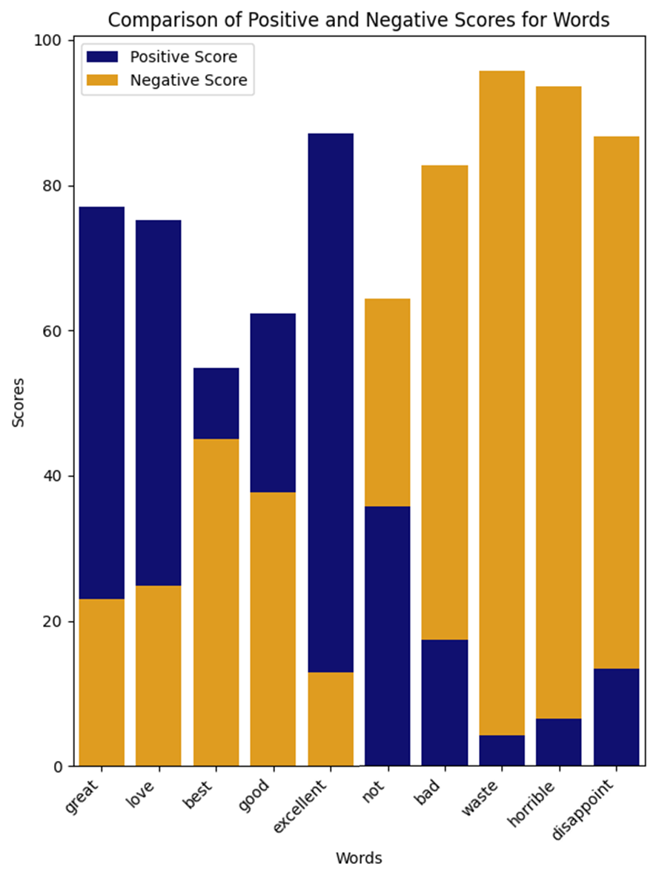
4. Feature Engineering
Text length distribution
before and after cleaning
Comparison of positive and negative scores for words
more Centralized
after cleaning
( 𝝁 ~ 43, 𝝈 ~ 22)
Counts
Percentage
Counts
Percentage
Words
Comment Length
Words
Comment length

Slide 11
5. Transformation and vectorization
Bi-directional Encoding Representation for a Transformer
Cutting-edge NLP model to understand context of words and sentences
Reads text from left to right and right to left, crucial for understanding nuances and word relationships
multilingual language representation²
Word2Vec
GloVe
Static
Count Vector
TF-IDF
Word embeddings¹
Traditional
GPT
BERT
Contextual
¹Birunda and Devi (2021, p. 275) | ²Deepa (2021, pp. 1710–1713)
Notes:
Problems:
^{Sentiment Analysis}
^{Question Answering}
^{Sentiment Analysis}
^{Requires}
^{Language Understanding}

Slide 12
5. Transformation and vectorization – BERT
Input
Choose pre-trained purpose dictionary
65 words per sentence (𝝁 + 𝝈)
convert the words into numerical representations for each sentence
How BERT operates
Generates different output vectors for a same word when used in different context
contextual training and inference can be achieved
[array([1, 0, 0, ..., 1, 1, 0]), array([[ 101, 1252, 1174, ..., 13098, 2013, 1449],
[ 101, 3443, 13909, ..., 15112, 7342, 12808],
[ 101, 4990, 5816, ..., 0, 0, 0],
...,
[ 101, 1585, 27175, ..., 9684, 1267, 1407],
[ 101, 9979, 20449, ..., 0, 0, 0],
[ 101, 1278, 28434, ..., 0, 0, 0]],
I exercise in a gymnasium
[-0.2,0.1,2.1..]
A gymnasium is a german school
[0.6,0.2,-0.4..]
¹Ankiit (2022)

Slide 13
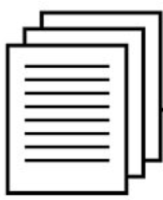

6. Model building - Overview
Comments
BERT
1
Dense
activation='sigmoid'
Bidirectional LSTM
2
Metrics
Average Pooling
f1 Score
Max Pooling
Important Features
Convolutional Neural Network
Prediction
3
Batch Normalization
Accuracy = 91.13%
Max Pooling

Slide 14
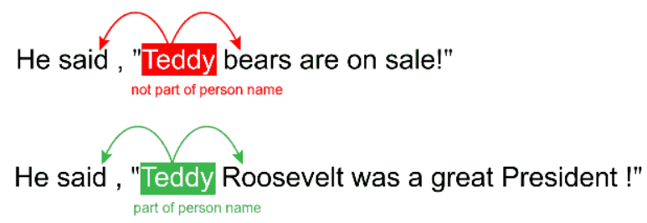
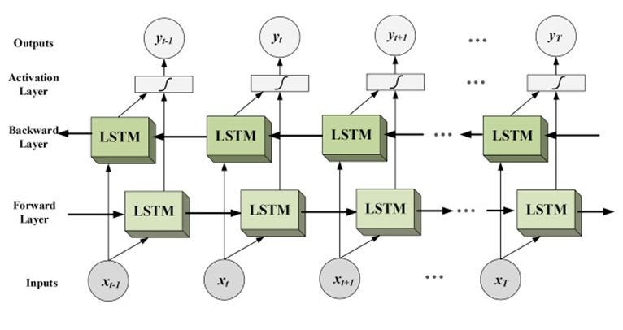

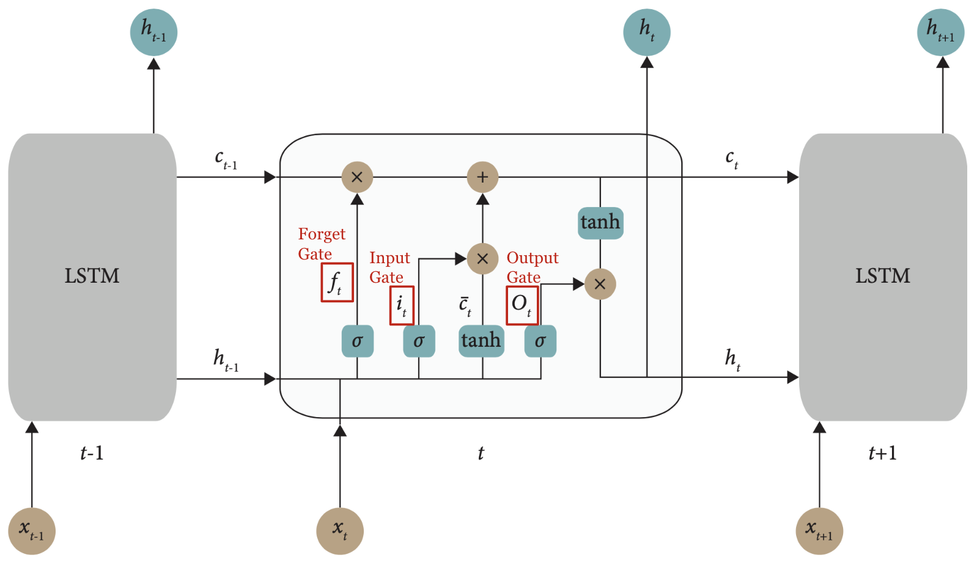
6. Model building - LSTM
Methods | Advantage
Bidirectional LSTM | Output of forward and backward layer at each stage is given to activation layer neural network and output of this activation layer is considered
LSTM
¹Chiny, M. et al. (2021)

Slide 15
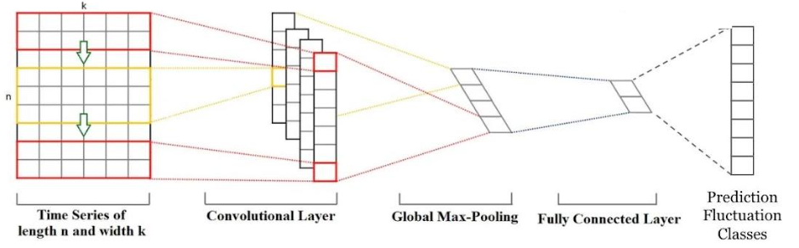
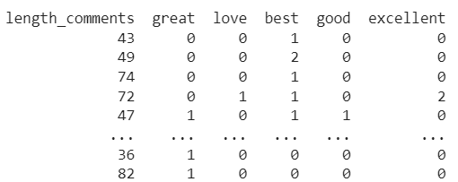
6. Model building - Convolutional Neural Network
Methods | Advantage
CNN Convolutional Neural Network | Utilizes 1D convolutions to identify repeating motifs Improves computational efficiency by incorporating pooling layers Focuses more on the dynamics of the time series data
CNN
Output layer
n and k representation of the data
Convolutional layer
Global Max-Pooling
Global max pooling
¹Z. Wang, W. Yan, and T. Oates (2017)

Slide 16
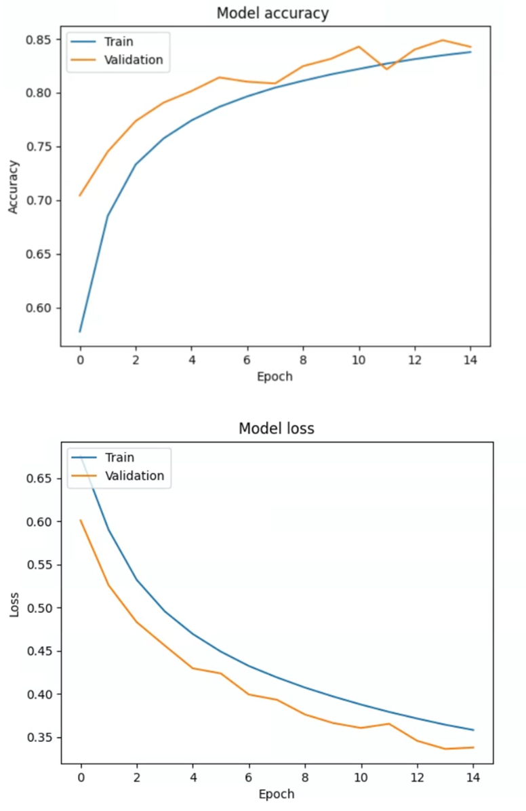
7. Model training and results
Model accuracy
Model loss
Model Training: 80%
Model Validation: 20%
of the original training data

Slide 17
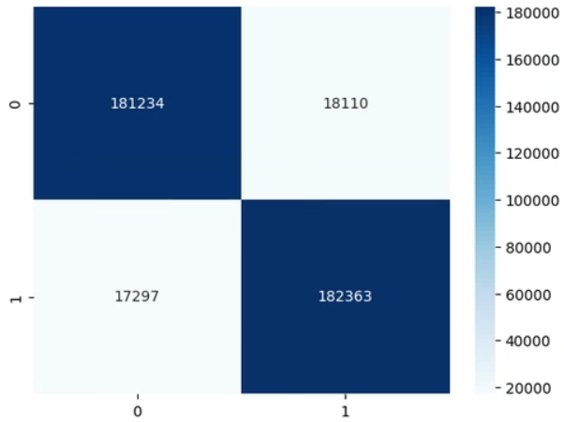
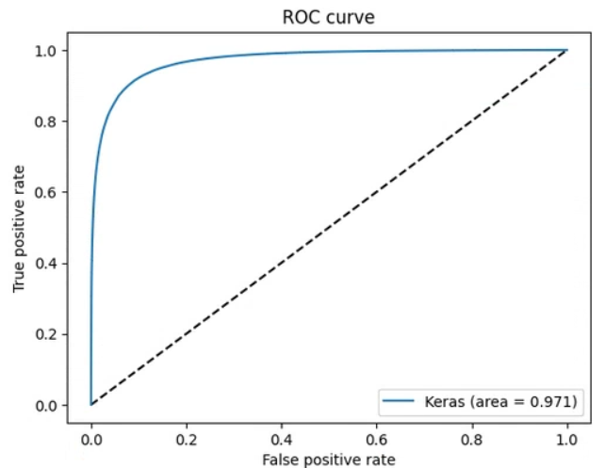
7. Model training and results
Accuracy = 0.913
Confusion Matrix
ROC Curve
0: Positive comment
1: Negative comments
0: Positive comments
1: Negative comments

Slide 18




8. Further business application
Employee Feedback
Improve working environment
Collect employee feedback and do surveys, improve workplace satisfaction
Brand Building
Do the comparison
Understand how our brand is perceived in the market and identify areas for improvement
Sentiment Analysis
Competitor Analysis
Strengths / Weaknesses
Identify strengths and weaknesses in competitor offerings to inform your company's strategic decisions
Monitoring
About Social Media
Analysis of social media to access consumers’ thoughts and real-time response 🡪 allow company to adjust
¹Sharma (2023)

Slide 19
9. Resources
BlAbubakar, H.D. and Umar, M. (2022) 'Sentiment Classification: Review of text vectorization methods: Bag of Words, TF-IDF, Word2VEC and Doc2VEC,' SLU Journal of Science and Technology, 4(1 & 2), pp. 27–33. https://doi.org/10.56471/slujst.v4i.266.
Chiny, M. et al. (2021) 'LSTM, VADER and TF-IDF based Hybrid Sentiment Analysis Model,' International Journal of Advanced Computer Science and Applications, 12(7). https://doi.org/10.14569/ijacsa.2021.0120730.
Mikolov, T. et al. (2013) 'Efficient estimation of word representations in vector space,' arXiv (Cornell University) [Preprint]. http://export.arxiv.org/pdf/1301.378.
Hernández, N., Batyrshin, I. and Sidorov, G. (2022) 'Evaluation of deep learning models for sentiment analysis,' Journal of Intelligent and Fuzzy Systems, 43(6), pp. 6953–6963. https://doi.org/10.3233/jifs-211909.
Pennington, J., Socher, R. and Manning, C. (2014) 'Glove: Global Vectors for Word Representation,' Computer Science Department, Stanford University, Stanford, CA 94305 [Preprint]. https://doi.org/10.3115/v1/d14-1162.
Deepa, D. (2021) 'Bidirectional Encoder Representations from Transformers (BERT) Language Model for Sentiment Analysis task: Review,' Turkish Journal of Computer and Mathematics Education (TURCOMAT), 12(7), pp. 1708–1721. https://doi.org/10.17762/turcomat.v12i7.3055.

Slide 20
9. Resources
Birunda, S.S. and Devi, R.K. (2021) 'A review on word embedding techniques for text classification,' in Lecture notes on data engineering and communications technologies, pp. 267–281. https://doi.org/10.1007/978-981-15-9651-3_23.
Vaswani, A. et al. (2017) 'Attention is all you need,' arXiv (Cornell University) [Preprint]. https://doi.org/10.48550/arxiv.1706.03762.
Ankiit (2022) 'Word2vec vs BERT - Ankiit - Medium,' Medium, 19 March. https://medium.com/@ankiit/word2vec-vs-bert-d04ab3ade4c9.
Sharma, S. (2023) Top 10 applications of Sentiment Analysis in Business https://www.analyticsvidhya.com/blog/2023/01/top-10-applications-of-sentiment-analysis-in-business/
Alap Shah, “Nike Seizes Controversy By The Bullish Horns”, Forbes, 12 Sept. 2018.
https://www.forbes.com/sites/alapshah/2018/09/12/a-social-media-and-sentiment-analysis-of-nike-what-does-it-mean-for-future-purchase-intent/
F. Casciati, R. Liang, W. Liu, S. Kaewunruen, H. Zhang, and Z. Wu, “Classification of External Vibration Sources through DataDriven Models Using Hybrid CNNs and LSTMs,” Structural Control and Health Monitoring, vol. 2023, p. 1900447, 2023, doi: https://doi.org/10.1155/2023/1900447.
Shah, A. (2018) 'Nike Seizes Controversy By The Bullish Horns,' Forbes, 12 September. https://www.forbes.com/sites/alapshah/2018/09/12/a-social-media-and-sentiment-analysis-of-nike-what-does-it-mean-for-future-purchase-intent/?sh=3aa94e3a2f45.

Slide 21
9. Resources
keras Team, “Keras documentation: Code examples,” keras.io. https://keras.io/examples/
N. Srivastava, G. Hinton, A. Krizhevsky, and R. Salakhutdinov, “Dropout: A Simple Way to Prevent Neural Networks from Overfitting,” Journal of Machine Learning Research, vol. 15, pp. 1929–1958, 2014, Available: https://www.jmlr.org/papers/volume15/srivastava14a/srivastava14a.pdf?utm_content=buffer79b43&utm_medium=social&utm_source=twitter.com&utm_campaign=buffer
Z. Wang, W. Yan, and T. Oates, “Time series classification from scratch with deep neural networks: A strong baseline,” in International Joint Conference on Neural Networks (IJCNN), 2017, pp. 1578–1585. doi: https://doi.org/10.1109/IJCNN.2017.7966039.
S. Ioffe and C. Szegedy, “Batch Normalization: Accelerating Deep Network Training by Reducing Internal Covariate Shift,” arXiv.org, 2015. https://arxiv.org/abs/1502.03167
S. Hochreiter and J. Schmidhuber, “Long Short-Term Memory,” Neural Computation, vol. 9, no. 8, pp. 1735–1780, Nov. 1997
J. Han, J. Pei, and H. Tong, Data Mining: Concepts and Techniques, vol. p365. Morgan Kaufmann, 2022. Accessed: Jun. 30, 2023. [Online] . Available: https://books.google.com.tw/books?hl=en&lr=&id=NR1oEAAAQBAJ&oi=fnd&pg=PP1&dq=Data+Mining:+Concepts+and+Techniques&ots=_M9KMNylqX&sig=h3Cwr5Ct4r4v-GvRv9oVoJTPg6Y&redir_esc=y#v=onepage&q=Data%20Mining%3A%20Concepts%20and%20Techniques&f=false

Slide 22
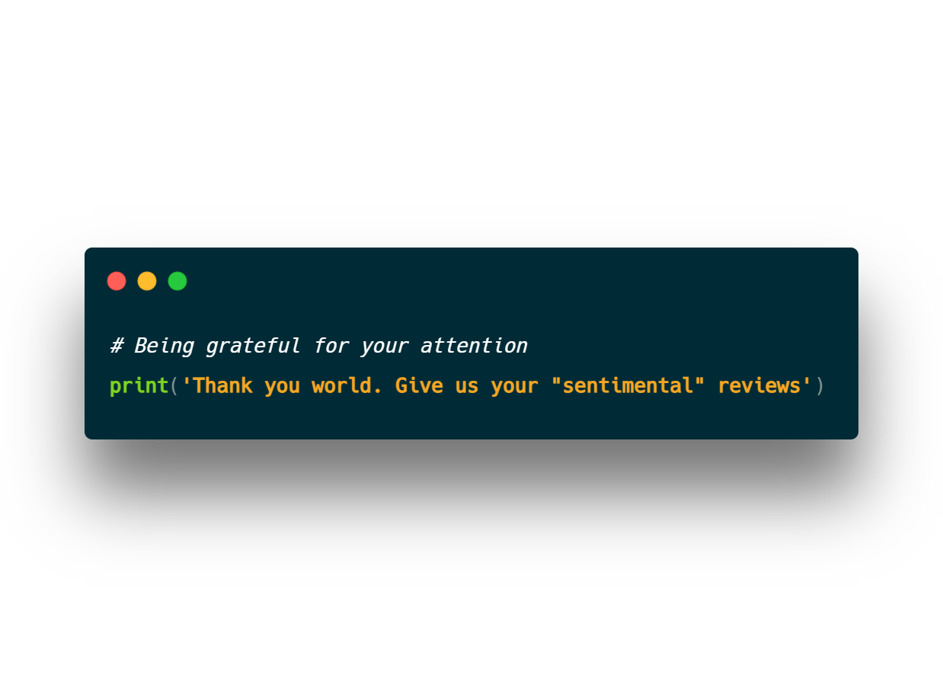

Slide 23

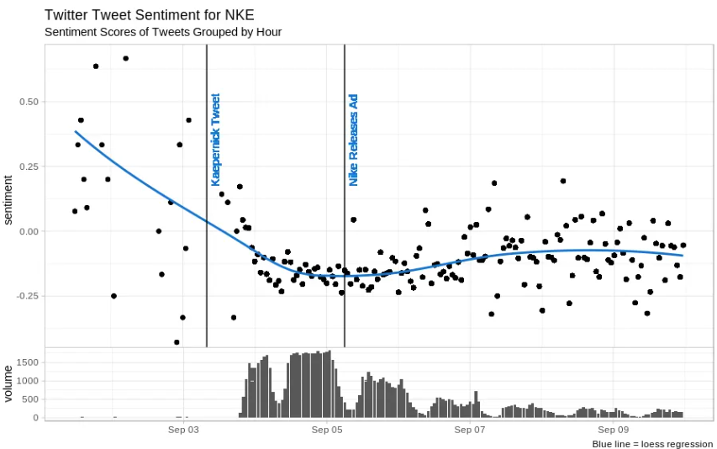
8. Further business application - Example
Nikes sponsored Colin Kaepernick 2 years after his mediatized knee-down
Turned negative publicity into good
Forbes used sentiment analysis on Tweets for nike marketing “move”
¹Shah (2018)

